Slide 1
Building Connections
2023 Buffalo County Community Partners Volunteer Orientation
Notes:
Welcome new partner! We are so excited that you are interested in creating greater impact for well-being in our community.
What are YOU interested in?
Where do you see yourself working in or on?
What are your strengths.

Slide 2
Who We Are
We identify issues in our community.
We collect and evaluate data and
invest the time to understand the issue.
We facilitate community conversations to find innovative solutions.
We connect people to essential resources.
Notes:
Mission Statement
Build connections among people who share the passion to
measure, promote and strengthen community well-being.

Slide 3
Who We Are
Non-profit organization based in Kearney, NE
Formed in 1996, by a group of 25 community stakeholders interested in Building a Healthier Community
Known for county wide assessments using data to gauge community wellness
Using multi sector collective impact model
Rich history of success in reducing youth alcohol use, empowering youth, and coordinating resources in the community
Notes:
Non-profit organization based in Kearney, NE
Formed in 1996, by a group of 25 community stakeholders interested in Building a Healthier Community
Known for county wide assessments using data to gauge community wellness
Using multi sector collective impact model
Rich history of success in reducing youth alcohol use, empowering youth, and coordinating resources in the community

Slide 4
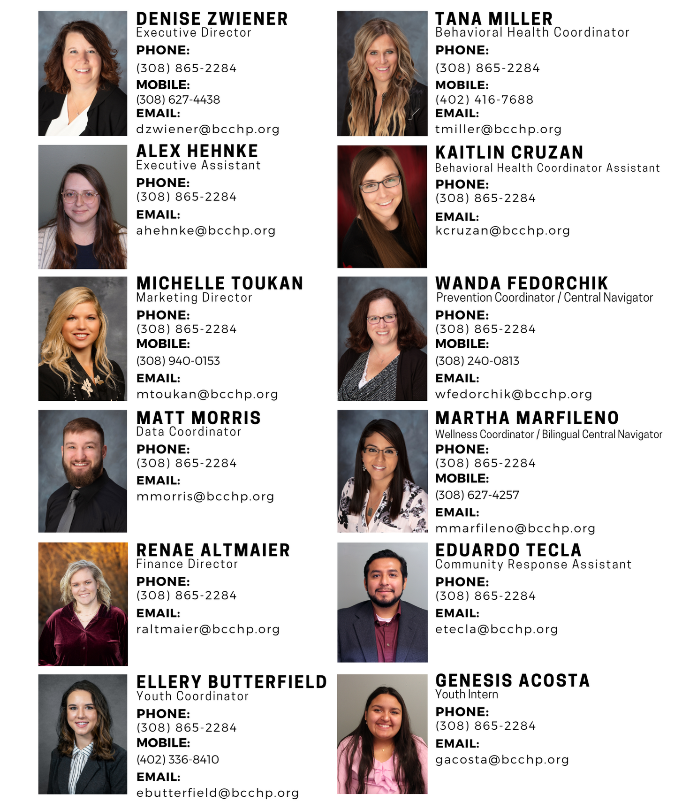
Staff
Notes:
5 operational staff – assist with backbone functions
Prevention staff and assistants
Grant writers
Building connections for prevention

Slide 5
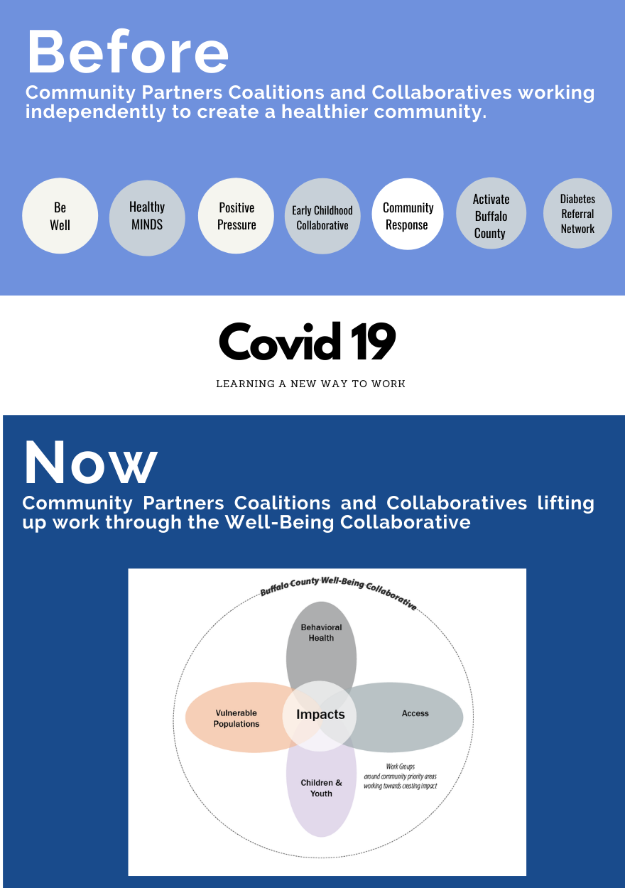
Building a
2030 Vision
Notes:
How we got here today
Buffalo County Community Partners identifies issues impacting community’s well-being and addresses those
issues by collecting and evaluating data and facilitating conversations among interested parties and community members.
We have a rich history of prevention, youth empowerment, and coordination of resources.
Community Partners Coalitions and Collaboratives worked independently to create a healthier community.
We launched HelpCare Clinic which developed from issues of people in our community who are underinsured or non insured not having a place to receive services.
2020 - immediate need for resource collaboration in the community.
Planning for 2030 – decided to utilize what we were learning from cross sector collaboration and collective impact

Slide 6
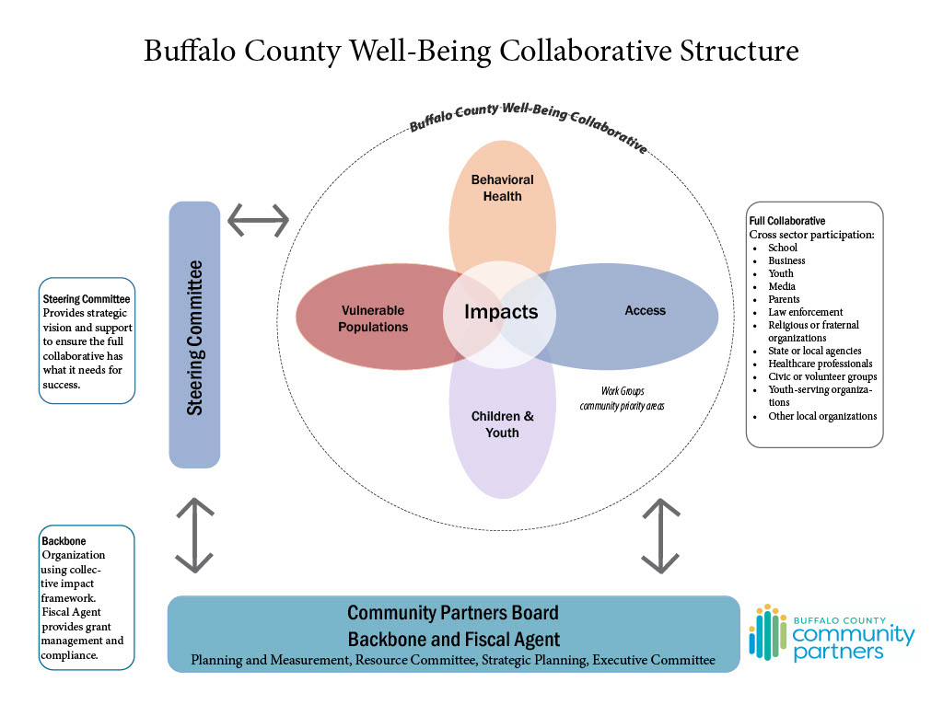
Collaborative Structure
Notes:
Working towards the 2030 vision.
Well-Being Collaborative: participation from 12 different community sectors
Collaborative impacting community. Impact in the center of the four work group circles.
Community Partners serves as the backbone and fiscal agent
Steering committee: provides strategic vision and support

Slide 7
Impact Statements
What is the Collaborative Trying to Accomplish?
Prevent persons across the lifespan from entering systems due to issues, challenges, or problems that are preventable.
Increase access to information, resources, skill building, programs, and services.
Notes:
What is collaborative doing? Trying to create impact in community.
Prevent persons across the lifespan from entering systems due to issues, challenges, or problems that are preventable.
Increase access to information, resources, skill building, programs, and services.

Slide 8
Building a
2030 Vision
Notes:
Foundations of the Well-Being Collaborative
Today we will
explore the six foundations of the Well-being collaborative.
Prevention efforts BCCP staff is facilitating
How you can get involved

Slide 9
Community
Model
Notes:
Collective Impact Model
Point to a shared agenda,
See many sectors involved,
Know the benefits when issues are solved together,
Give voice to those being served,
See work through others perspective,
Give space for others to join conversations,
Celebrate success together and for each other.

Slide 10
Measuring Impact
Results Based Accountability Model
Notes:
How do we know anyone is better off from all the work our community has done?
Not just measuring outcomes
How much we do
How well we do it
Is anyone better off

Slide 11
Notes:
Community data
Broken into 4 areas called performance indicators; behavioral health, early childhood/adolescents, access, vulnerable person
Establish baseline metrics for the collaborative

Slide 12
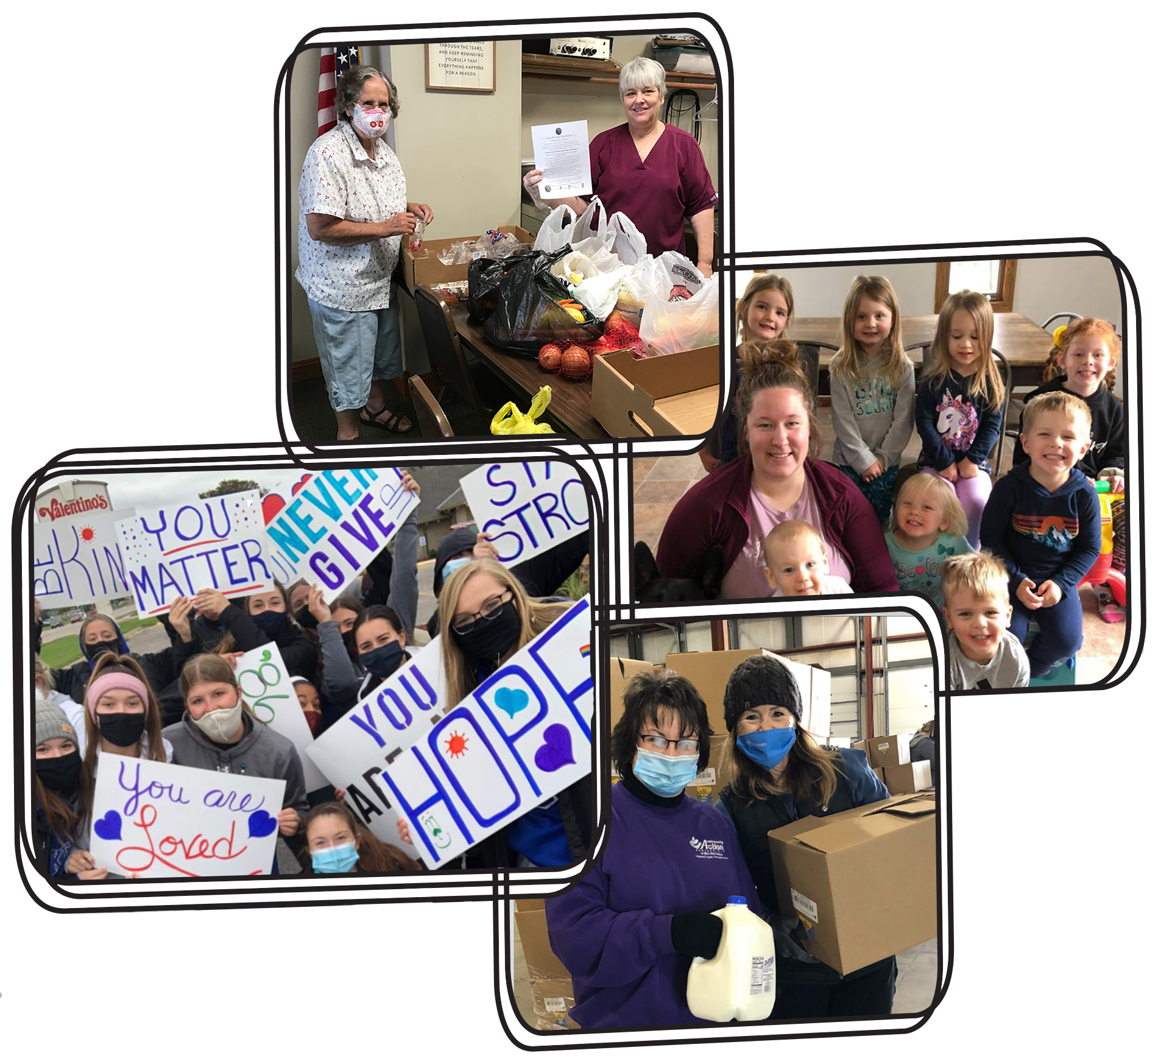
Vision Statements
By 2030, our communities’
Will have resources that are easy to understand and accessible.
Will have access to basic services.
Will thrive when partners work together to coordinate services.
Will value all people and their voices will inform our work.
Notes:
formed through data and
60+ partner discussions on hopes for the community
Helps orient the work

Slide 13
Collaborative Structure
Notes:
Well-Being Collaborative: participation from 12 different community sectors
‘IMPACT’ in the center of the four work group circles.
Community Partners serves as the backbone and fiscal agent
Steering committee: provides strategic vision and support

Slide 14
Adding Value
Do you see yourself in this work?
Do you have resources to share?
Do you share our vision?
Does your vision align with this work
Get involved
Join our email list
Join our collaborative meetings
Make a financial investment
Notes:
Ask Partners:
What interests, resources, etc. they have to share.
Where do you see your work in this model?
Would you like to join the collaborative email list to stay informed?
Do you want to attend meetings regularly to join in these/other conversations?
Show relevant prevention work in other areas.

Slide 15
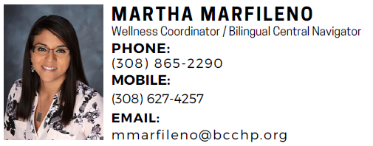
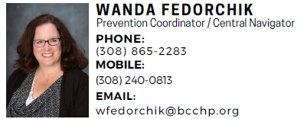
Community Partners Work
Community Work Facilitated by
Community Partners Staff
Buffalo County Community Response Coalition
Mission: Community Response is the actions a community takes to develop a coordinated system of resources and services which strengthen families and enhance family well-being.
Funding NE Children and Families Foundation
This team helps ~ 200 individuals/families annually find supports for food, housing, technology, and other basic needs assistance when no other community supports were available.
Provides individuals with life coaching to reach sustainability.
Notes:
We have funding to promote prevention strategies in the community.
Community Work Facilitated by Community Partner Staff

Slide 16
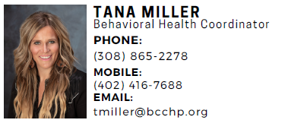
Community Partners Work
Community Work Facilitated by
Community Partners Staff
Early Childhood Collaborative & Rooted in Relationships
Focused on increasing access and resources for quality childcare providers
Raise awareness of the importance of early childhood and why an investment – time, resources, and knowledge – in early childhood is the foundation of a thriving community
Helping local communities bring awareness to childcare shortages and connecting to resources for solutions
Rooted in Relationships provides evidence-based practices that enhance the social-emotional development of children
Notes:
We have funding to promote prevention strategies in the community.
Community Work Facilitated by Community Partner Staff

Slide 17
Community Partners Work
Community Work Facilitated by
Community Partners Staff
Housing and Emerging Issues Taks Force
Case managers and community leaders working to solve housing gaps and barriers
Case managers discuss complex housing situations, brainstorm resources and solutions
Short term solutions to immediate problems: backpacks assembled to give to those looking for housing
Notes:
We have funding to promote prevention strategies in the community.
Community Work Facilitated by Community Partner Staff

Slide 18
Community Partners Work
Community Work Facilitated by
Community Partners Staff
Positive Pressure Coalition
Aid communities in coordination of resources and use of evidence-based practice to reduce substance abuse.
Decreasing youth alcohol use and other substances by connecting parents access to resources.
Host prescription takeback events.
Provide free prescription lockboxes and gun locks to the community.
Notes:
We have funding to promote prevention strategies in the community.
Community Work Facilitated by Community Partner Staff

Slide 19
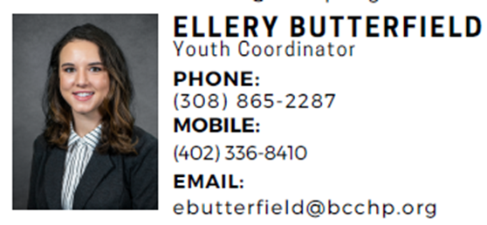
Community Partners Work
Community Work Facilitated by
Community Partners Staff
PhotoVoice
This program is designed for youth to develop creative self-expression and constructive communication skills through photography.
Youth Advisory Board
Buffalo County Youth Advisory Board (YAB) is a program and a philosophy that recognizes youth as valuable resources in our community and empowers them as equal community partners to bring about positive community change. The youth tackle a range of social problems that concern them from our economy and environment to safety, substance abuse, and behavioral health.
Notes:
We have funding to promote prevention strategies in the community.
Community Work Facilitated by Community Partner Staff

